Slide 1

Scholarship Providing System
Project Title
Karthick B, 1912067
Jesu Pandian J, 191206
Guided by : Mr. Rajesh Kumar S – AP/CSE

Slide 2

Most students studies around the world gets affected due to insufficient money for projects and studies so we thought a simple solution which solves not every problem but some students around us.
MY FIRST STEPS TOWARDS SOLVING STUDENTS FINANCIAL PROBLEM

Slide 3

Objective
The mission of the Scholarship Providing System is to increase opportunities for student access to and success in higher education and contests by helping students in financial support.

Slide 4
ABSTRACT
The Scholarship Providing Forum mainly focuses on providing scholarship for those who has skills but in need of money to achieve something, it includes highly paid certifications and higher studies. Someone can get scholarship fund by providing the details of eligibility criteria they have to do that study, one who want to enroll in this system must need select a premium pack which decides the range of scholarship amount that they can avail for. Also, there will be a module which enhances donation to the public from corporation, government or helping hands. All request will be public in forum with an upvote option so a person who is highly skilled and can efficiently use the forum will be noticeable with the help of public upvote and also a request with most downvote will automatically get rejected, one can avail for scholarship only restricted time which will be decided by the premium pack chosen by them. A special module will focus on forum scam and forgery by completely verifying the study details provide by them, if someone who tries to scam the forum and is proved will be permanently banned without any appeal. A person from forum availed for scholarship for a competition or hackathon will must need to submit their result from officials of that and also if they won some money means they can pay back to the forum to maintain stability of fund in forum

Slide 5

Reference :
1. scholarshipmonkey.com
2. collegeboard.org
3. fastweb.com

Slide 6





Technologies
React JS
Node JS
MySQL
NPM
Git Hub
Front-End
Backend
Database System
Plugins and Miscellaneous Library
Version Control

Slide 7
Current Progress
Q1
Q2
Q3
Q4
Module Design and Planning
Frontend and Design
Backend and API
Deploy and Testing
Completed
In Progress…
Pending
Pending

Slide 8






Key Points
Best under Crowd
A person with skills but in need of financial aid can be easily found.
Using emerging technologies
Emerging frameworks and libraries are being used so upgrading will be easy.
Low Entry Fee
Cause of low entry fee most students can benefit from the from.
User Friendly and Secured
Easy to request a scholarship with an user friendly form and
Unity is Power
Every single cent donate by forum member will glow a students life.
Sharing Success
Who won using our financial aid will be shared through out the forum and gets appreciated.

Slide 9
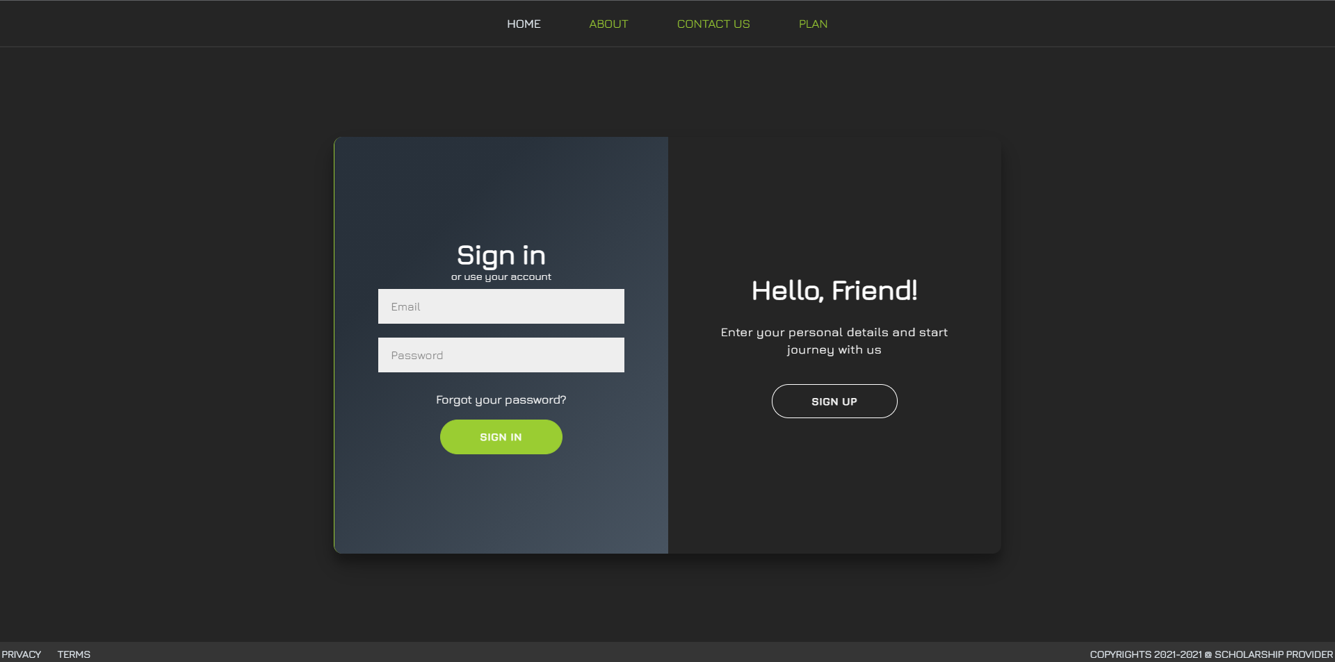
Work Done So Far
Home Page

Slide 10
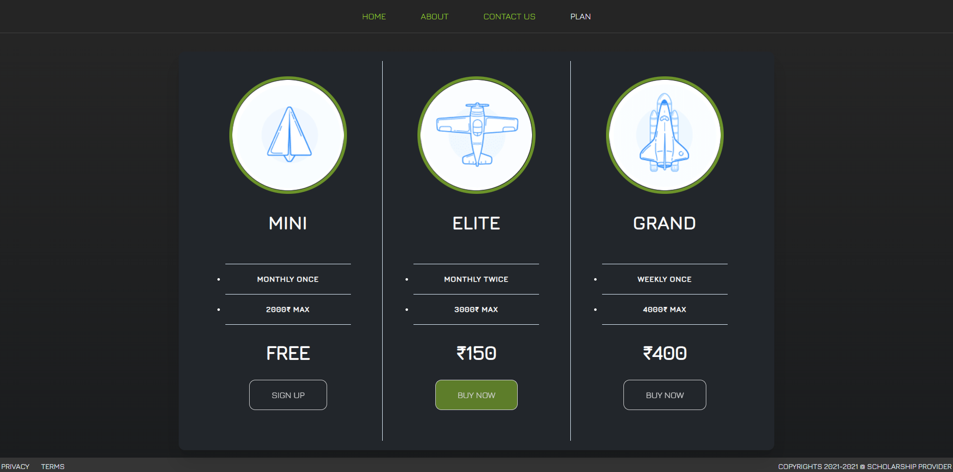
Plans Page

Slide 11
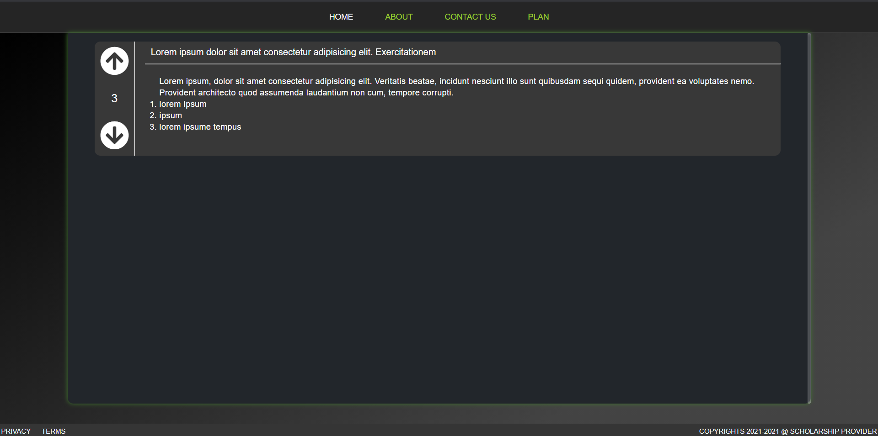
Scholarship Request Page

Slide 12

Conclusion
The scholarship providing system will light up students journey with a great help from the members and we hope the forum will create a family of members work together for others education.
The frontend progress will be completed within a week and will proceeded to backend development
Thank You

